Slide 2
Absence of Copyright
This slideshow contains photos, diagrams, and information, some of which were attained through internet searches of public websites. The author of this presentation does not own the copyright on this information, so this slideshow is for personal use only—not for sale or profit. Please utilize it to seek the Lord and grow in your knowledge of His Word and ways.
Bro Stan’s Revelation Study is available on our church website:
www.faithprinceton.org

Slide 4
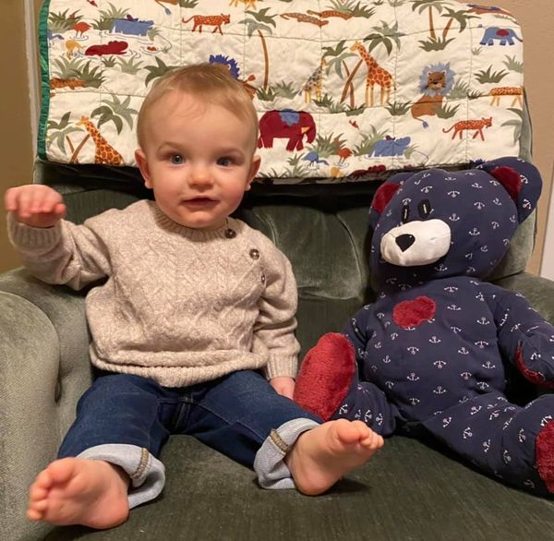
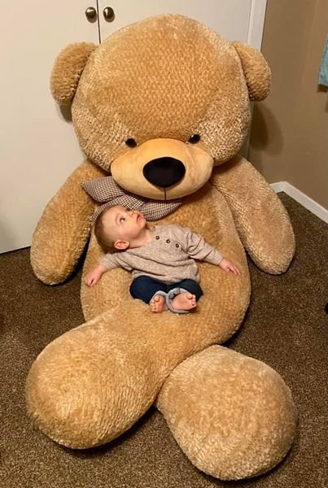
Noah at 9 months

Slide 5
Prayer and Announcements
Sundays Facebook Live or In-person:
9:15 Small Group Sunday School Classes
Greg Bowers teaches on Facebook Live
10:30 Worship (Facebook or YouTube)
SPECIAL GUEST: Denver Bierman
Mask in and Mask out...

Slide 6
Prayer and Announcements
PRAYER FOR OUR NATION:
Inauguration of President Joe Biden
Need for Unity
Coronavirus Variants and Spike
Gospel: Good News!
Notes:
Local Prayers:
Pray for church and our mission to share the Gospel... Vision for post Covid-19 ministry
Coronavirus illnesses: Jamie, Saucedas (especially Beto), Tommy Stapleton’s mom, Julie’s friend etc.
PRAISE: Lamar and Mary’s daughter Kathy and family doing well
Charles McAnally’s uncle passed away from sudden heart attack
Cindy Smith: slow healing of leg.... What to do about neck
Lindsey health issues

Slide 8
BEGIN HERE January 20, 2021
Week 32 – Revelation 22
Come Lord Jesus Come
Notes:
Revelation 22:1-5
1 And he showed me a river of the water of life, clear as crystal, coming from the throne of God and of the Lamb, ² in the middle of its street. On either side of the river was the tree of life, bearing twelve kinds of fruit, yielding its fruit every month; and the leaves of the tree were for the healing of the nations.
3 There will no longer be any curse; and the throne of God and of the Lamb will be in it, and His bond-servants will serve Him; 4 they will see His face, and His name will be on their foreheads. 5 And there will no longer be any night; and they will not have need of the light of a lamp nor the light of the sun, because the Lord God will illuminate them; and they will reign forever and ever.
Water of life = refreshment, sustenance
12 Fruit trees of life = nourishment, sustenance, satisfaction (filling), enjoyment (taste)
Healing Leaves = health, welfare, healing, strength
Newport (324) The eternal life God gives the redeemed community will be perpetually available, will sustain, and will cure every former sin.
(325)

Slide 9
Revelation 22:14-15 What Gives You the Right?
14 Blessed are those who wash their robes, so that they will have the right to the tree of life, and may enter the city by the gates.
15 Outside are the dogs, the sorcerers, the sexually immoral persons, the murderers, the idolaters, and everyone who loves and practices lying.
Notes:
Blessed ➔ seventh and last beatitude
V 14 How do we wash our robes? Newport (330) salvation involves obedience and discipleship
Revelation 2:7 He who has an ear, let him hear what the Spirit says to the churches. To the one who overcomes, I will grant the right to eat from the tree of life in the Paradise of God. Revelation 7:14 "Sir," I answered, "you know." So he replied, "These are the ones who have come out of the great tribulation; they have washed their robes and made them white in the blood of the Lamb.
Have the right to the tree of life = can get past the angels and the flaming sword?
John 14:6 Jesus saith unto him, I am the way, the truth, and the life: no man cometh unto the Father, but by me.
Gen 3:22-24 22 Then the Lord God said, “Behold, the man has become like one of Us, knowing good and evil; and now, he might reach out with his hand, and take fruit also from the tree of life, and eat, and live forever”— 23 therefore the Lord God sent him out of the Garden of Eden, to cultivate the ground from which he was taken. 24 So He drove the man out; and at the east of the Garden of Eden He stationed the cherubim and the flaming sword which turned every direction to guard the way to the tree of life.

Slide 10
Revelation 22:16-17 Let the Thirsty Come
16 “I, Jesus, have sent My angel to testify to you of these things for the churches. I am the root and the descendant of David, the bright morning star.”
17 The Spirit and the bride say, “Come.” And let the one who hears say, “Come.” And let the one who is thirsty come; let the one who desires, take the water of life without cost.
Notes:
Jesus’ statement of authentication. Testimony. Assurance of validity.
Root and descendant of David ➔ messiah! Branch and seed of David... Eternal kingdom...
Bright morning star ➔ He is the bright star which leads up the dawn of everlasting day (Malachi 4:2; 2Peter 1:19).
Spirit and Bride (church) say: “Come.” Evangelistic sermon!!!
The one who hears = believes the Gospel and is converted ➔ then joins in sharing the Good News: “Come to Jesus”
The one who is thirsty = Isaiah 55:1 "Come, all you who are thirsty, come to the waters; and you without money, come, buy, and eat! Come, buy wine and milk without money and without cost!
The one who desires =
Take the water of life without cost = still available as long as the end has not come!!!
John 7:37 In the last day, that great day of the feast, Jesus stood and cried, saying, If any man thirst, let him come unto me, and drink.
Threefold “come/let him come” present imperative ➔ urgency and availability until the end

Slide 11
Revelation 22:18-19 Don’t Add or Take Away
18 I testify to everyone who hears the words of the prophecy of this book: if anyone adds to them, God will add to him the plagues that are written in this book;
19 and if anyone takes away from the words of the book of this prophecy, God will take away his part from the tree of life and from the holy city, which are written in this book.
Notes:
John or Jesus? = I testify
Don’t add or take away from the words of Revelation!! Could apply to the whole Bible !!
God will add the plagues to those who add
God will take away their part from the tree of life and from the holy city
Deuteronomy 4:2; 12:32
Deuteronomy 4:2 You must not add to or subtract from what I command you, so that you may keep the commandments of the LORD your God that I am giving you. Deuteronomy 12:32 See that you do everything I command you; do not add to it or subtract from it.
Galatians 1
6 I am amazed that you are so quickly deserting Him who called you by the grace of Christ, for a different gospel, 7 which is not just another account; but there are some who are disturbing you and want to distort the gospel of Christ. 8 But even if we, or an angel from heaven, should preach to you a gospel contrary to what we have preached to you, he is to be accursed! 9 As we have said before, even now I say again: if anyone is preaching to you a gospel contrary to what you received, he is to be accursed!

Slide 12
Revelation 22:20-21 Maranatha!
20 He who testifies to these things says, “Yes, I am coming quickly.” Amen. Come, Lord Jesus.
21 The grace of the Lord Jesus be with all. Amen.
Notes:
Jesus : Yes, I am coming quickly. (SOON)
Our prayer: Aramaic: Maranatha ➔ Come Lord Jesus
1 Corinthians 16:22
21 The greeting is in my own hand—that of Paul. 22 If anyone does not love the Lord, he is to be accursed. Maranatha! 23 The grace of the Lord Jesus be with you. 24 My love be with you all in Christ Jesus. Amen.
NEWPORT: we live with two great prayers on our lips:
Thy Kingdom come, Thy will be done on earth as it is in heaven
Amen. Come Lord Jesus.
A prayer for today and a prayer for tomorrow!

Slide 13
Revelation 22:20-21 Maranatha!
Two Great Prayers on the lips of believers...
Thy Kingdom come, Thy will be done on earth as it is in heaven
A prayer for God’s movement in the world TODAY
Amen. Come Lord Jesus.
A prayer of anticipation and HOPE for TOMORROW
Notes:
Jesus : Yes, I am coming quickly. (SOON)
Our prayer: Aramaic: Maranatha ➔ Come Lord Jesus
1 Corinthians 16:22
21 The greeting is in my own hand—that of Paul. 22 If anyone does not love the Lord, he is to be accursed. Maranatha! 23 The grace of the Lord Jesus be with you. 24 My love be with you all in Christ Jesus. Amen.
NEWPORT: we live with two great prayers on our lips:
Thy Kingdom come, Thy will be done on earth as it is in heaven
Amen. Come Lord Jesus.
A prayer for today and a prayer for tomorrow!

Slide 15
CONCLUSIONS from the Book of REVELATION
Thinking about where we started...

Slide 16
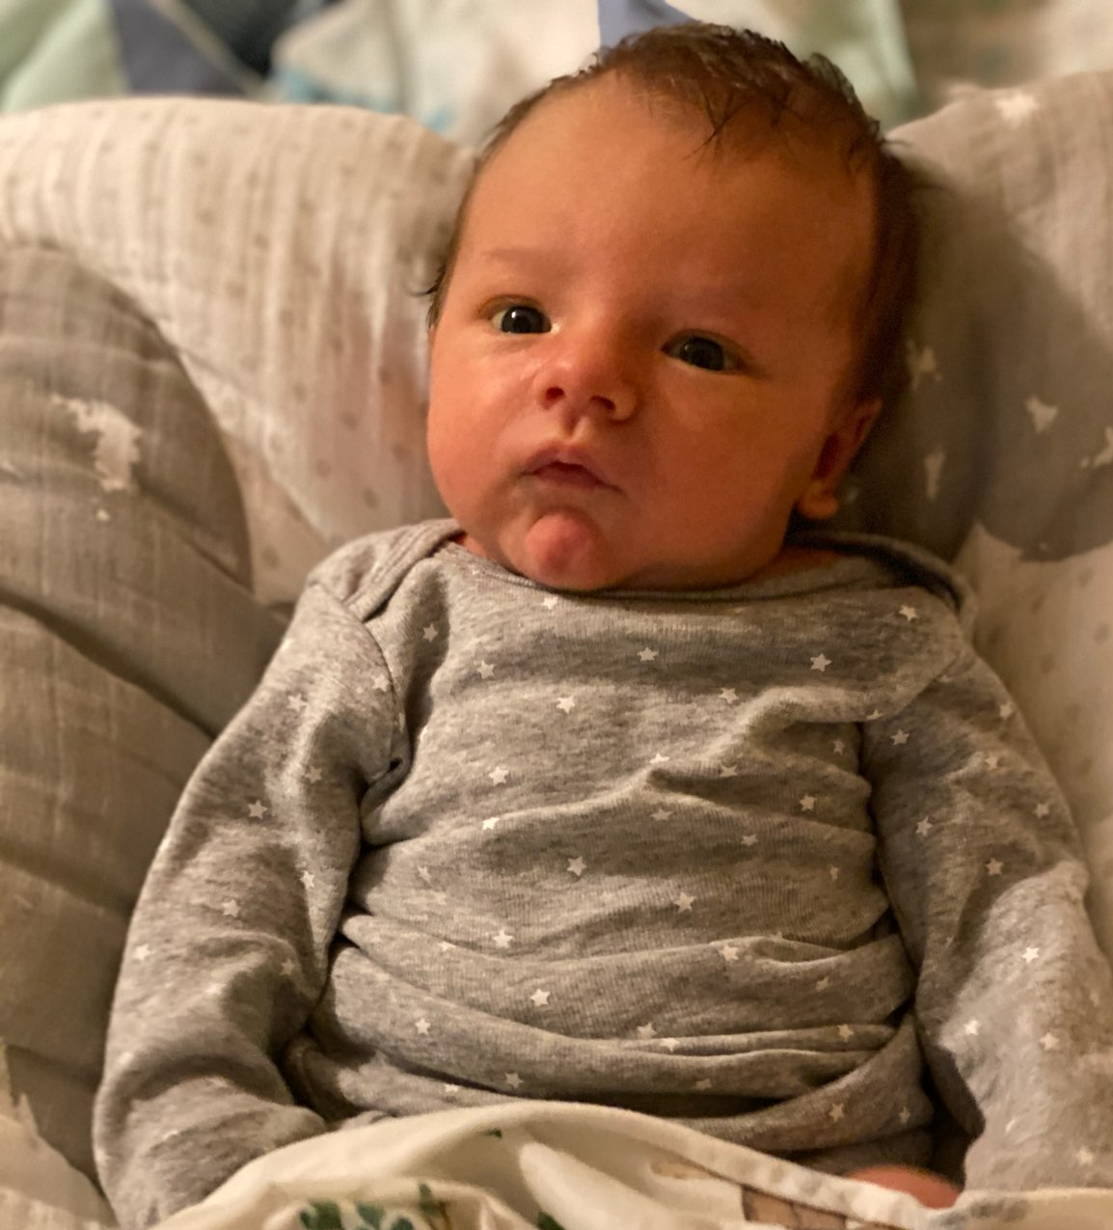
The first photo of my grandson Noah...
One month old!

Slide 17
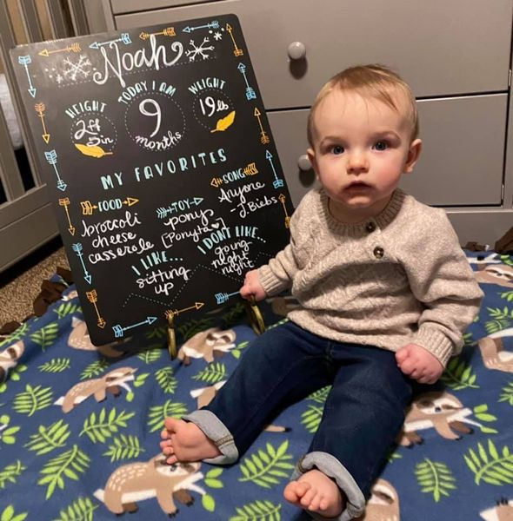
The latest photo of Noah...
Now 9 months old!!!

